Slide 1
This is really it
November 20, 2021 - Final delegate’s report

Slide 2
We’re going to do three things in the next 30 minutes: No stats, no numbers.

Slide 3
1. Acknowledge where we’ve been

Slide 4
2. Look at where we are now

Slide 5
3. Talk about the future

Slide 6
Let’s acknowledge…
The past

Slide 7
I have carried memories with me from four of our Delegates over the last 15 years (myself excluded) P56 – Cindy E. P53 – Colleen G. P50 – Bette R. P47 – Roland C.

Slide 8
I remember when… P47 – Roland C. and the KBDM breakout

Slide 9
Then there was… P50 – Bette R. and the Conflict Resolution rollout

Slide 10
And along came… P53 – Colleen G. and the Dual Members language

Slide 11
Finally, my world exploded when… P56 – Cindy E. brought the St. Francis Prayer discussion

Slide 12
I didn’t know then What I know now (I was developing a desire to become a Delegate, because I loved interacting with these people and the way they included me)

Slide 13
So I ask you…
Over the past three years, have you heard something during a delegate’s report that has stuck with you?

Slide 14
Let’s have 5 people share (1 min.)

Slide 15
Let’s look at where we are now…
A few things I’ve noticed:
Attendance is down – we lost some regulars and gained a few new folks
Alateen shrunk – all around the us
We’re in limbo – we still have temporary electronic meetings and in-person events are up in the air, but we know we will have to transition back to face-to-face

Slide 16
We’re just not there yet.

Slide 17
In the meantime…
Here’s what I’ve been up to lately:
I sent a package of love gifts to Australia

Slide 18
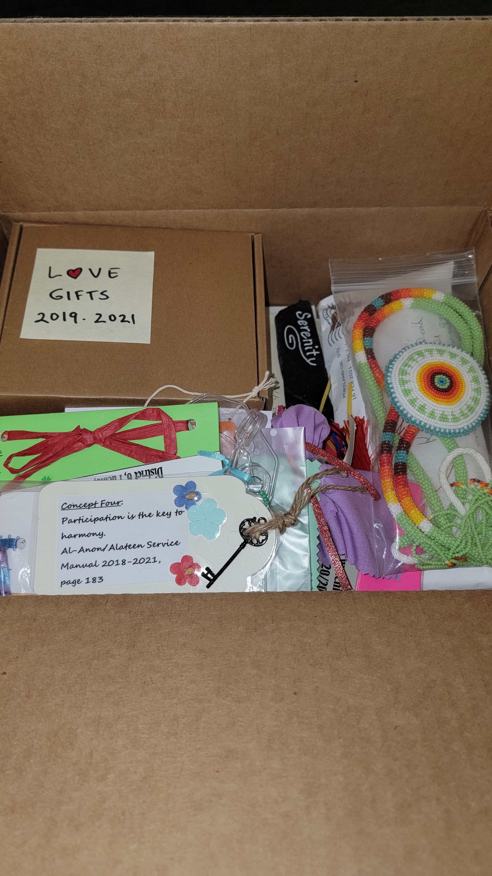

Slide 19
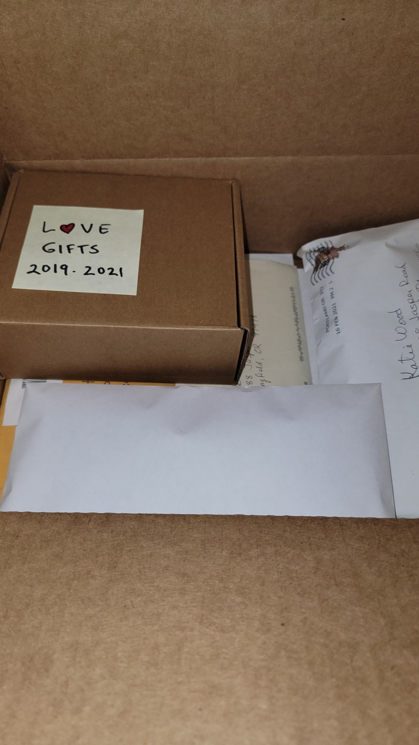

Slide 20
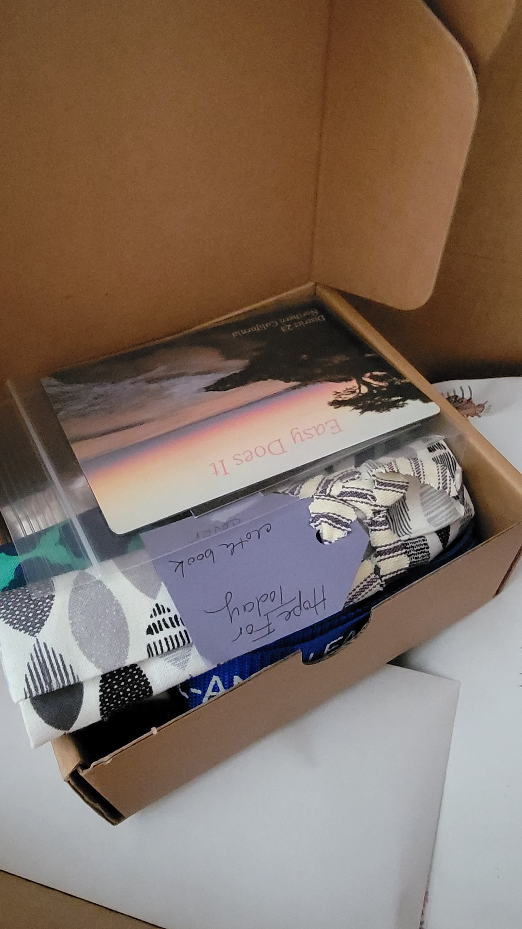

Slide 21
I’ve been working on my final mailing

Slide 22
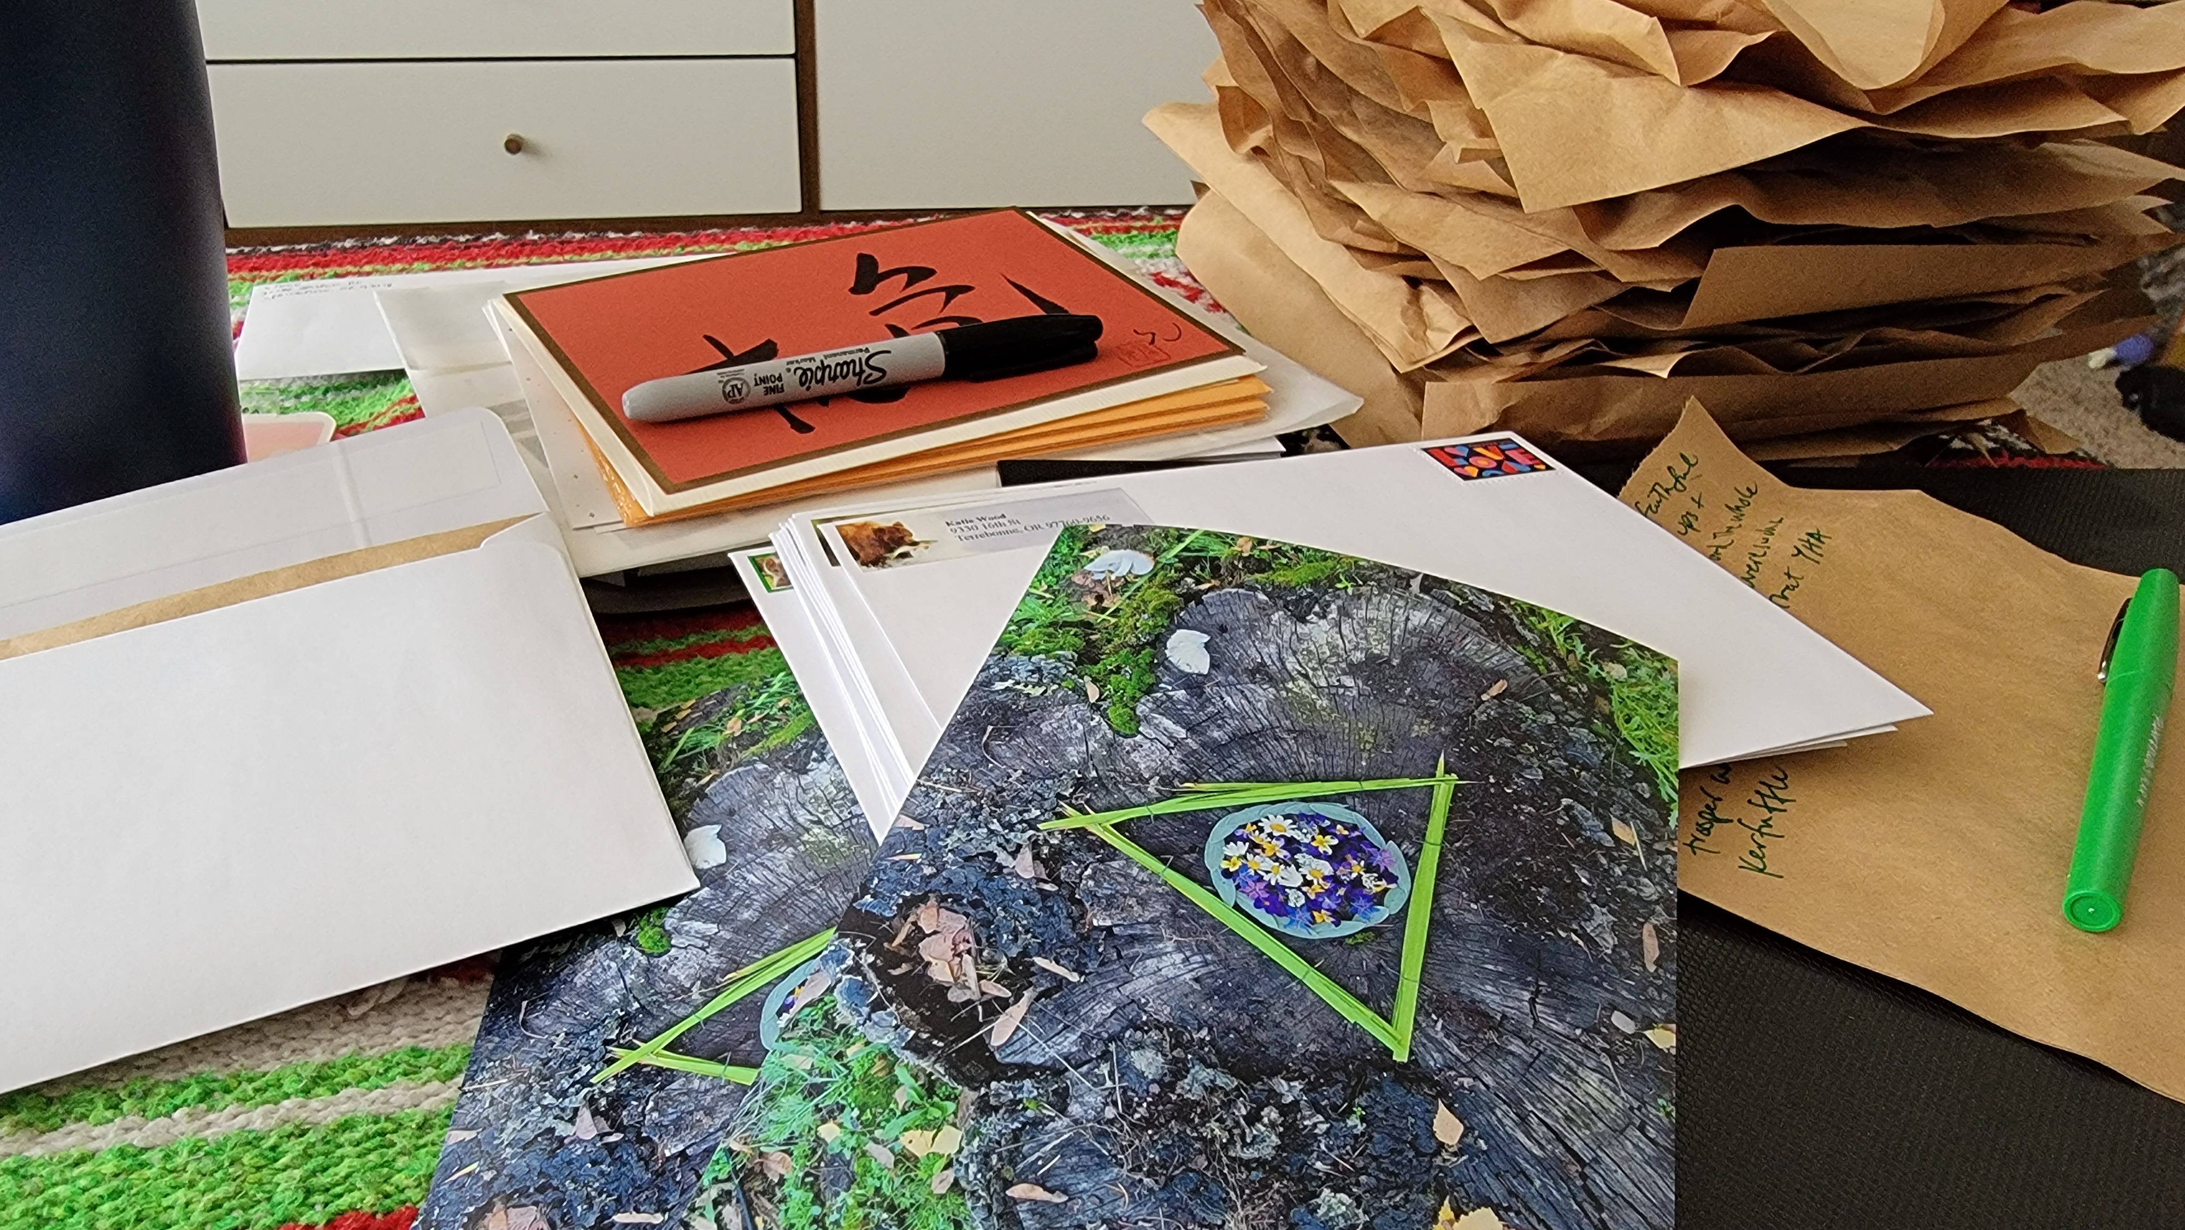

Slide 23
Here’s a photo I snapped of a banner in Springfield!

Slide 24
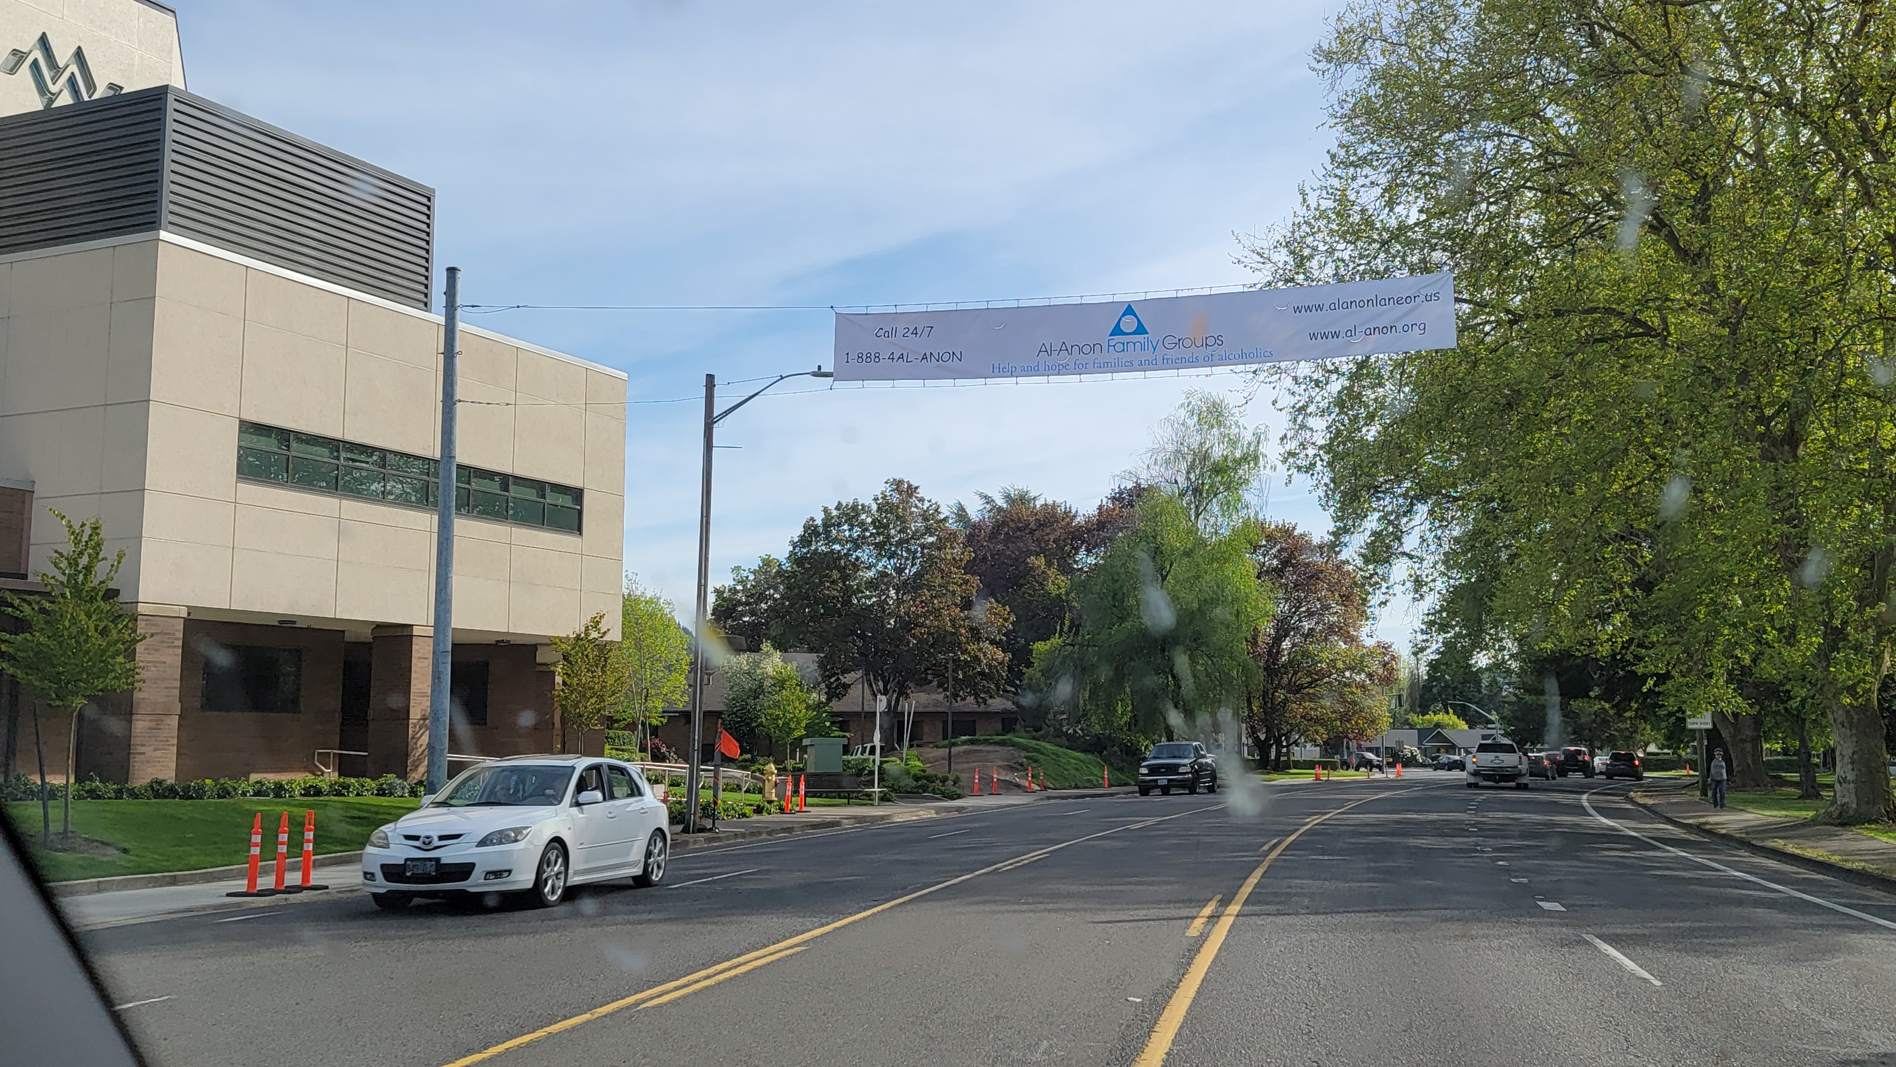

Slide 25
Where are we headed?
One thing I do know:
The Native American Al-Anon Conference is coming! No ifs ands or buts.

Slide 26
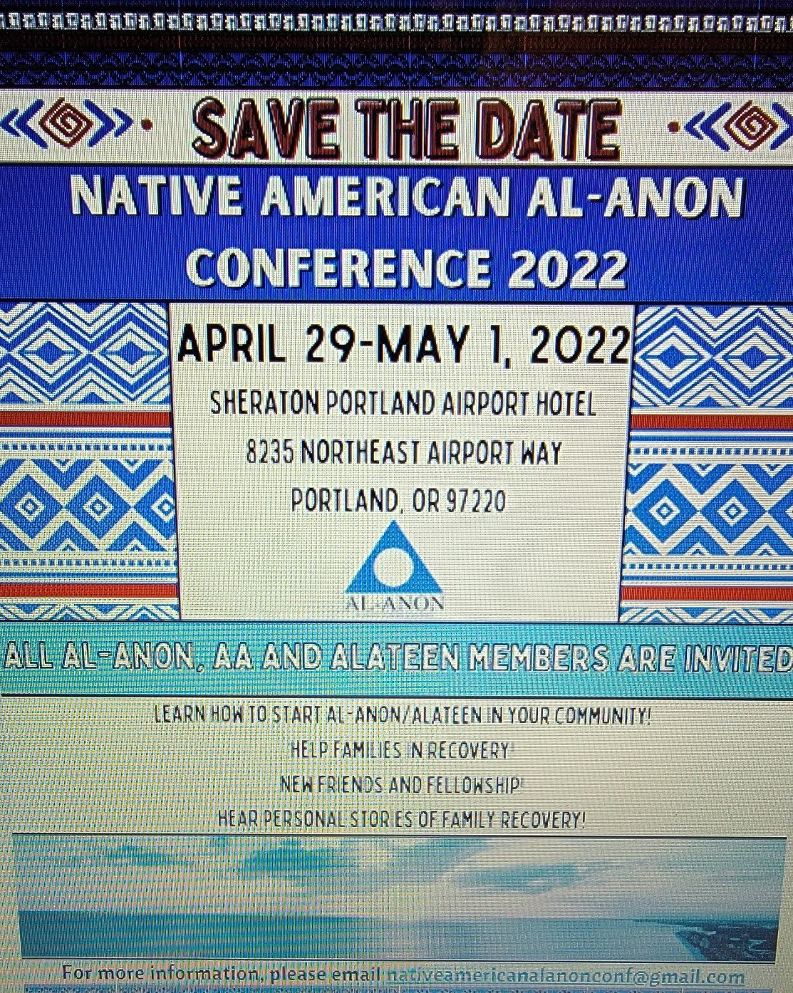

Slide 27
Now I want to hear from you…
What do you dream for Al-anon?
I hear people talk about what they want to change, but that’s not what I mean.
What do you dream for our program?

Slide 28
My dream is that Oregon would have multi-cultural outreach across the state and that all people who come, would feel at home in an Al-Anon meeting.

Slide 29
What’s your dream? Let’s have 3 people share (1 min.)

Slide 30
As always, it’s been a privilege to serve as your Delegate. I love all of you - thank you for such an amazing three years together.

